Slide 1
Fall HIV Conference Update (Part 2)
Raj Gandhi, MD
Massachusetts General Hospital
Harvard Medical School
Acknowledgments:
Annie Luetkemeyer, Erica Shenoy, Arthur Kim, Courtney Tern
Disclosures: none

Slide 2
Current ART
New ART
Comorbidities and Coinfections
PrEP

Slide 3
When to START? The Sooner, the Better
Current ART
New ART
Coinfections
PrEP
START: randomized trial of immediate vs. delayed ART in PWH with CD4 count >500
Primary results (previously published): early initiation of ART reduced AIDS and non-AIDS related complications
Participants who were originally assigned to deferred ART group were all recommended to start ART.
Median follow-up: about 9 years.

Slide 4
Current ART
New ART
Coinfections
PrEP
Even after starting ART, CD4 counts remain lower in Delayed Group than in Early Group

Slide 5
Risk of complications associated with delaying ART diminishes after ART is started, but some excess risk still persists
Current ART
New ART
Coinfections
PrEP
Notes:
Add citation for this and other studies

Slide 6
Implications: Need to Diagnose and Treat HIV Earlier
Current ART
New ART
Coinfections
PrEP
Delayed ART initiation associated with higher rate of complications, perhaps related to immune dysregulation “legacy effect”
High levels of inflammation before ART correlate with high levels while on ART
Even in high income countries, median CD4 cell count at ART initiation is <400; almost 20% have CD4 cell count <200
We need to do better job of testing, diagnosing and treating all PWH.
Edwards JK et al, Ann Int Med, 2021; Lee JS et al, CID, 2020; IeDEA and COHERE Cohort Collaborations, CID, 2018; Gandhi RT, McMahon DK et al, PLoS Pathogens, 2017

Slide 7
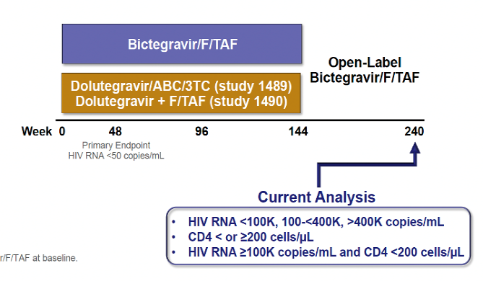
Bictegravir/FTC/TAF in PWH With High Baseline HIV RNA and/or Low CD4 Count
Current ART
New ART
Coinfections
PrEP
Many recent ART trials enrolled participants with high CD4 counts
Less known about efficacy/safety of modern ART in PWH with low CD4 count and/or high baseline HIV RNAs
~600 adults received BIC/FTC/TAF in manufacturer-sponsored studies
80 had baseline CD4 <200, 119 had VL >100,000

Slide 8
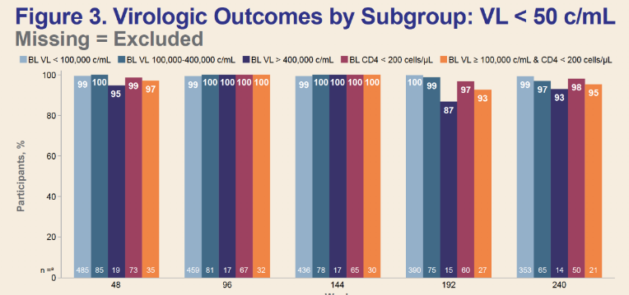
Current ART
New ART
Coinfections
PrEP
High rate of virologic suppression with Bictegravir/FTC/TAF in PWH With High Baseline HIV RNA and/or Low CD4 Count
At 5 years of ART, among participants who remained in study, virologic suppression rates high for low baseline CD4 group and for high baseline HIV RNA group
Greater median weight gain among those with low CD4 and/or HIV RNA at baseline

Slide 9
What are the ART options for PWH who have drug resistance?

Slide 10
High Efficacy of Switching to Bictegravir/FTC/TAF with Suppressed HIV and pre-existing M184V/I
HIV RNA <50 (LOCF)(at last visit)
Pooled data from 6 trials in which PWH and virologic suppression switched to B/F/TAF (n=1825 with baseline data)
Preexisting M184V/I identified in 182 participants (10%)
98% of participants with pre-existing M184V/I maintained viral suppression
99%
98%
99%
100%
100%
Patients (%)
All Patients*
(n=1825)
All
(n=182)
+NNRTI-R
(n=97)
+PI-R
(n=58)
+INSTI-R
(n=4)
M184V/I
LOCF: last observation carried forward.
*Patients with baseline data.

Slide 11
PIBIK Study: Switch to Bictegravir/FTC/TAF From Boosted PI Regimens With Drug Resistance
Phase 4 (investigator initiated)
HIV RNA <50 on boosted PI regimen
Genotype:
M184V/I ± NRTI-associated mutation
M184 V/I alone
Up to 2 TAMs ± M184 V/I
Any of the above ± NNRTI mutations
No INSTI mutations
Immediate Switch to Bictegravir/FTC/TAF
(n=31)
Randomization
1:1
Continue Boosted PI Regimen (n=36)
Delayed Switch to
Bictegravir/FTC/TAF
Week 0 24 48
TAMs: thymidine analogue mutations.
Primary endpoint: HIV RNA <50 at week 24.
Baseline demographics:
Male: 89%.
Median CD4 632 cells/μL.
Boosted darunavir (81%) and atazanavir (19%).
Genotype:
≥2 NRTI (47%), M184 V/I only (26%).
Iwuji C, et al. J Int AIDS Soc. 2022;25(suppl 6):89-90. Abstract P089
Slide from Practice Point Communications
.
Notes:
Current ART

Slide 12
PIBIK Study: Outcomes Following Switch to Bictegravir/FTC/TAF
Presence of limited NRTI resistance did not compromise virologic efficacy after switch to bictegravir/FTC/TAF in virologically suppressed adults on boosted PI regimens
HIV RNA <50 Copies/mL (week 24)
100%
97%
Patients (%)
Switch to Bictegravir/F/TAF
(n=33)
Continue
Boosted PI Regimen
(n=39)
Iwuji C, et al. J Int AIDS Soc. 2022;25(suppl 6):89-90. Abstract P089
Slide from Practice Point Communications
.

Slide 13
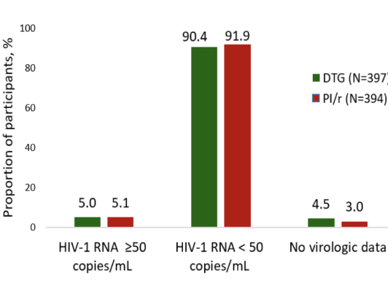
2SD: Switching Treatment Experienced PWH from PI/r to DTG
Randomized study in Kenya (n=795)
Participants with viral suppression on second line ART with PI/r + 2 NRTIs randomized to switch to DTG + 2 NRTI or continue PI/r + 2 NRTI
Prior drug resistance not assessed but anticipated to be common
High rate of virologic suppression in people switched to DTG + 2 NRTIs
No treatment emergent INSTI or PI resistance
Week 48 Results

Slide 14
NADIA: 2nd-Line ART after NNRTI Failure
Participants with virologic failure on TDF/3TC/NNRTI (n=464)
Randomized to switch to DTG or DRV/r with either TDF/3TC or AZT/3TC
Study participants:
CD4 <200: 51%; VL >100,000: 28%
Resistance: K65R/N: 50%; M184V: 86%
DTG + 2 NRTIs non-inferior to DRV/r + 2 NRTIs
High rate of suppression even when no NRTIs predicted to be active!
Continuing TDF/3TC superior to switch to AZT/3TC
9 participants (4%) in DTG group developed resistance; no resistance in the DRV/r group
HIV RNA <400 Copies/mL
(ITT, week 96)
P=NS
92%
P=0.02
90%
87%
85%
Participants (%)
Dolutegravir
(n=235)
Darunavir/r
(n=229)
TDF
(n=233)
ZDV
(n=231)

Slide 15
Lessons from Trials of Switching ART
In treatment experienced patients with viral suppression, switching from PI/r to DTG maintains viral suppression even when resistance testing results not known
In PWH who are virologically suppressed and have virus sensitive to INSTIs and PIs, switching to tenofovir/XTC + high barrier to resistance drug (DTG, BIC, DRV/r) likely to maintain suppression, even with pre-existing NRTI resistance
In PWH with virologic failure with extensive NRTI resistance but INSTI and PI sensitivity, options include boosted DRV + 2 NRTI; DTG + boosted DRV; alternate: DTG + 2 NRTI (small risk of DTG resistance)

Slide 16
Regimens to Consider in Someone Who Acquires HIV While on Pre-Exposure Prophylaxis
TDF/FTC or TAF/FTC PrEP
Bictegravir/FTC/TAF Dolutegravir + tenofovir/XTC Darunavir/cobi + tenofovir/XTC
Cabotegravir PrEP
Darunavir/cobi + tenofovir/XTC
Adjust regimen once results of HIV genotype return

Slide 17
December 1, 2022

Slide 18
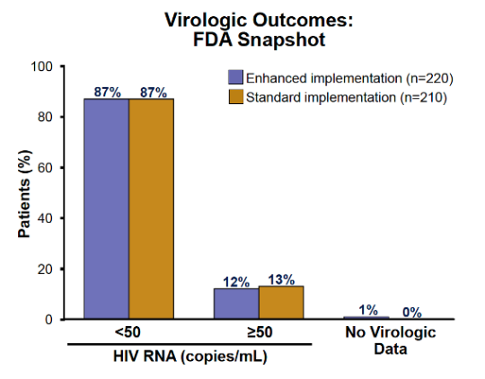
CARISEL: Long-acting Cabotegravir/Rilpivirine
Current ART
New ART
Coinfections
PrEP
CAB/RPV approved in Jan 2021 for treatment of PWH who are virologically suppressed and do not have resistance to CAB or RPV
CARISEL study evaluated implementation of CAB/RPV at clinics in Europe
Sites randomized to standard implementation or enhanced implementation
430 participants enrolled and treated
At 1 year, 87% of participants maintained virologic suppression (similar across arms)

Slide 19
LA Cabotegravir/Rilpivirine: Considerations
Current ART
New ART
Coinfections
PrEP
Techniques proposed to minimize injection discomfort
slowing speed of injection,
ensuring that the medication reaches room temperature
having the patient relax their muscle prior to injection
Clinics should develop systems to offer LA option to patients who prefer alternative to daily oral therapy.
Need to know whether LA injectables improve HIV suppression rates in people who struggle to take daily antiretrovirals; studies ongoing.
Need to develop LA drugs that can be self administered

Slide 20
What’s on the Horizon?
Pharmacokinetic study in healthy patients without HIV (n=15) of CAB/RPV LA injections into lateral thigh muscles
Plasma concentrations of both drugs higher than level anticipated to suppress HIV (based on protein adjusted-IC₉₀)
If additional data are supportive, may allow for self-administration
Han K et al, AIDS 2022, Abstract EPB176; Benn P, et al. AIDS 2022; Abst. PESUB24.

Slide 21
New ART

Slide 22
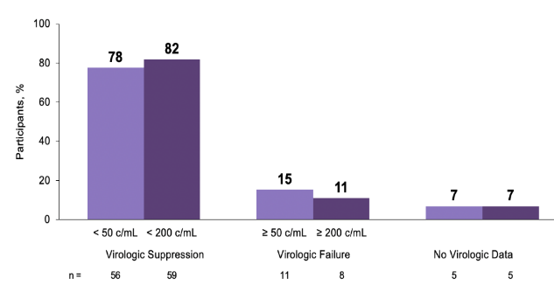
Current ART
New ART
Coinfections
PrEP
Lenacapavir (LEN) + Optimized Background Regimen (OBR) in People with Multi-drug Resistant HIV (CAPELLA)
LEN: HIV capsid inhibitor; dosed every 6 m by subcutaneous injection
In people with MDR HIV, LEN + OBR led to viral suppression in 82%
Treatment emergent resistance in 9 participants (1 in 8): M66I most common
All had no other active drugs or incomplete adherence to OBR
Virologic suppression at wk 52
Ogbuagu O, et al. IDWeek 2022. Abstract 1585; Segal-Maurer S, NEJM, 2022

Slide 23
Lenacapavir Approval
European Medicines Agency and European Commission recently approved LEN for treatment in combination with other ART
For use “in adults with multi-drug resistant HIV infection for whom it is otherwise not possible to construct a suppressive anti-viral regimen”
US FDA accepted NDA for lenacapavir June 27, 2022. Decision expected by December 27, 2022

Slide 24
Lymphocyte Changes With Islatravir + Doravirine
Current ART
New ART
Coinfections
PrEP
Islatravir: Nucleoside RT translocation inhibitor (NRTTI)
Studies placed on hold in 2021 because of dose dependent lymphopenia, decline in CD4 cell count
Phase 2b dose ranging study in treatment-naïve PWH
ISL 0.25 mg + DOR qd + 3TC
ISL 0.25 mg + DOR qd (n=29)
ISL 0.75 mg + DOR qd + 3TC
ISL 0.75 mg + DOR qd (n=30)
Islatravir Selected Dose
+ Doravirine qd
ISL 2.25 mg + DOR qd + 3TC
ISL 2.25 mg + DOR qd (n=31)
Doravirine/3TC/TDF (n=31)
Week 0 24 48 96
Switch Allowed
if HIV RNA
<50 Copies/mL
ISL: islatravir; DOR: doravirine.

Slide 25
Lymphocyte Changes With Islatravir + Doravirine
Current ART
New ART
Coinfections
PrEP
Exposure-related decreases in total lymphocytes, CD4 cell counts, and B-cell counts observed with islatravir doses ≥0.75 mg
Islatravir 0.25 mg + doravirine and doravirine + 3TC/TDF
Comparable increases in total lymphocytes and CD4 counts
Lymphocyte Change at Week 60
Total lymphocytes
CD4
80%
60%
47%
Change (%)
21%
24%
16%
-0.4%
-16%
DOR
3TC/TDF
(n=22)
0.25 mg
(n=19)
0.75 mg
(n=18)
2.25 mg
(n=16)
Islatravir Dose + Doravirine
Correl T, et al. J Int AIDS Soc. 2022;25(suppl 6):23. Abstract O46.
Slide adapted from Practice Point Communications

Slide 26
Islatravir: Clinical Trial Updates
Current ART
New ART
Coinfections
PrEP
In Sept 2022, FDA granted permission for resumed testing with lower dose of islatravir
Indication | Current status (October 2022)
PrEP (all patients) | All studies discontinued
Treatment treatment-naïve patients | Doravirine/ islatravir | Once-daily oral combination New Phase 3 study with a lower dose of islatravir
Treatment virally suppressed patients | Doravirine/ islatravir | Once-daily oral combination Two new Phase 3 studies with a lower dose of islatravir
 | Islatravir + lenacapavir | Once-weekly oral treatment Phase 2 study to resume with a lower dose of islatravir

Slide 27
Comorbidities and Coinfections

Slide 28
Weight Gain: ART Considerations
Weight gain common after ART initiation; may represent “return to health”
INSTI and TAF-based regimens associated with greater weight gain than regimens containing TDF or EFV
Weight gain more common in women and non-whites; mostly occurs during first year of ART initiation or switch
Exposure to EFV or TDF associated with weight suppression, compared with other ARVs
Whether weight gain is ameliorated by changing ART is not known
ACTG Do-IT study (doravirine switch); DEFINE trial (switching to TAF/FTC/DRV/cobi)
Notes:
Add first initials and increase font on all citations to about 14

Slide 29
INSTI Use and Incidence of CVD
Older PIs, ABC linked to CVD
RESPOND cohort: 29,000 PWH, of whom 14,000 received INSTI
Over median of 6 yr, 2.5% had CVD event
CVD incidence higher in those who received INSTI than in those who did not during first 6 mo of exposure
Difference between INSTI and non-INSTI groups disappeared over time
INSTI group more likely than non-INSTI group to have pre-existing CVD risk factors; raises possibility of residual channeling bias
Adjusted Incidence Rate Ratios for CVD
4
2
1
0.5
0.25
1.85
(1.44-2.39)
Adjusted IRR (95% CI)
0 0-6 6-12 12-24 24-36 >36
INSTI Exposure Time (months)
IRR: adjusted for demographics, traditional CVD risk factors, HIV-related factors, ART status, and concomitant or prior use of ARVs associated with CVD.
Notes:
Please pull reference

Slide 30
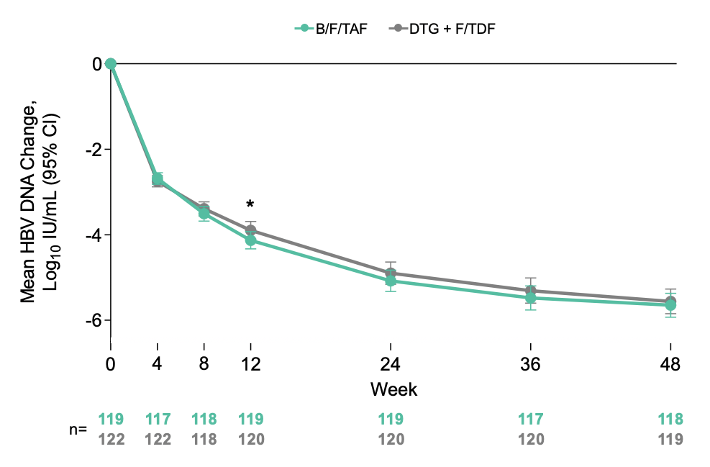
Randomized Trial of BIC/FTC/TAF vs DTG + FTC/TDF in PWH With HBV Coinfection (ALLIANCE)
At Wk 48, HBV suppression higher with TAF/FTC/BIC
Similar change in HBV DNA;
will DTG + FTC/TDF “catch up”?
Baseline demographics (median values):
Age: 32 years.
Asian/White/black/other: 88%/8%/3%/1%.
BMI: 22 kg/m².
HBV DNA: 8.1 log₁₀ IU/mL. HBeAg positive: 78%.
Avihingsanon A, et al. AIDS 2022. Abstract OALBX0105

Slide 31
Current ART
New ART
Coinfections
PrEP
Notes:
Add abstract number here and for all studies

Slide 32
Current ART
New ART
Coinfections
PrEP

Slide 33
Current ART
New ART
Coinfections
PrEP

Slide 34
HepB-CpG Vaccine in PWH without prior HBV Vaccination
Current ART
New ART
Coinfections
PrEP
Substantial proportion of PWH who receive conventional HBV vaccine do not achieve seroprotective levels of antibody to hepatitis B surface antigen
New hepatitis B vaccine adjuvanted with CPG (TLR-9 agonist) recently approved as 2-dose vaccine for most adults. Limited data in PWH
ACTG evaluated this vaccine in 74 PWH who had not previously been vaccinated

Slide 35
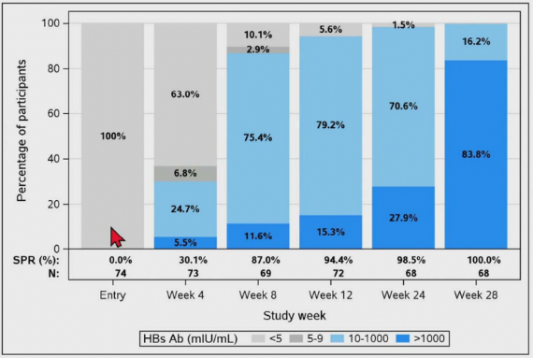
HepB-CpG Vaccine in PWH without prior HBV Vaccination
Current ART
New ART
Coinfections
PrEP
Participants were on ART. Median CD4 cell count 625, >95% had suppressed VL
98.5 % achieved seroprotective response (SPR) after 2 doses; 100% achieved SPR after 3 doses
Supports use of HepB CPG vaccine in PWH who are on ART with high CD4 counts, suppressed HIV RNA.
Upcoming data with this vaccine in PWH who are previous vaccine non-responders

Slide 36
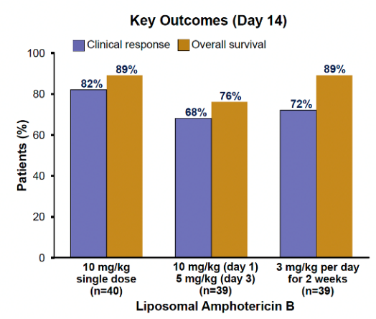
Single High-dose Liposomal Amphotericin B in Histoplasmosis
Current ART
New ART
Coinfections
PrEP
~120 patients with advanced HIV (median CD4 count 25) and disseminated histoplasmosis in Brazil randomized to receive induction therapy with single high dose of L-AmB, two doses of L-AmB, or 2 weeks of L-AmB
Oral intraconazole started on day L-AmB finished
Rate of clinical response at day 14 and overall survival similar in all three groups
Confirmatory phase 3 trial is needed and planned

Slide 37
Are PWH at higher risk for COVID-19 mortality?

Slide 38
a decentralized, placebo-controlled, randomized, platform clinical trial
McCarthy MW. Fluvoxamine for outpatient treatment of COVID-19: IDWeek 2022, Abstract LB1528A.
Boulware DR. Inhaled fluticasone for outpatient treatment of COVID-19. IDWeek 2022, Abstract LB1528B.
Naggie S. Ivermectin for treatment of mild-to-moderate COVID-19 in the outpatient setting. IDWeek 2022, Abstract LB1528C.
Notes:
https://www.natap.org/2022/IDWeek/IDWeek_23.htm

Slide 41
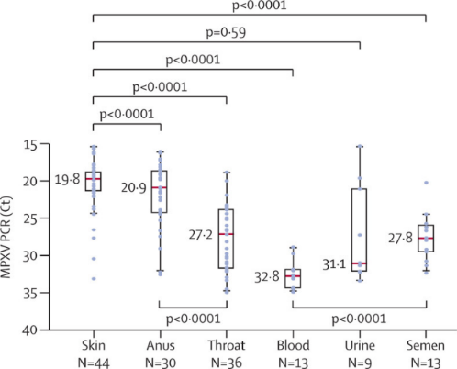
Transmission of Monkeypox Virus (MPXV)
Current ART
New ART
Coinfections
PrEP
MPXV viral loads
Main mode of transmission= sexual contact
Majority MSM, but heterosexual and non-sexual contact documented
Small number of transmissions through needle sticks, skin piercing, tattooing
Asymptomatic infections documented, but asymptomatic transmission not definitive
Skin and anal lesions contain highest concentration of virus
Risk of infection through fomites considered low
Samples collected from 50 men (Palich et al)

Slide 42
MPXV in Human Samples and Implications for Transmission
Current ART
New ART
Coinfections
PrEP
Exposure Source | MPXV DNA detected by PCR | Replication-competent virus detected/isolated | Epidemiologically supported source of infection
Skin | Yes | Yes | Yes
Oropharynx and saliva | Yes | Yes | Yes
Anorectum | Yes | Yes | Yes
Semen | Yes | Yes | Insufficient data
Urine/urethra | Yes | Yes | Insufficient data
Conjunctiva or ocular fluid | Yes | Yes | Insufficient data
Blood/plasma/serum | Yes | Insufficient data | Insufficient data
Feces | Yes | Insufficient data | Insufficient data
Vaginal fluid | Insufficient data | Insufficient data | Insufficient data
Breastmilk | Insufficient data | Insufficient data | Insufficient data
Contaminated sharp | Insufficient data | Insufficient data | Yes
MPXV detectable in many samples, but not all replication-competent or source of infection

Slide 43
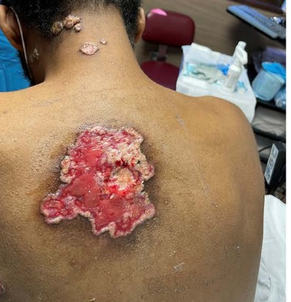
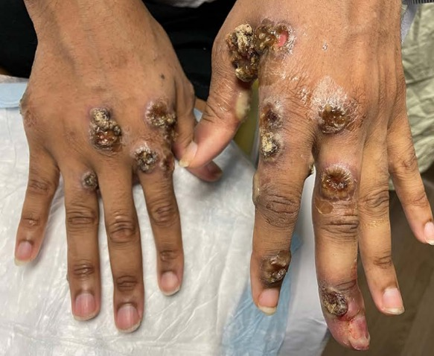
Severe Mpox in People with Advanced HIV
Current ART
New ART
Coinfections
PrEP
27,884 MPOX cases in US (10/21/22)
CDC consultation provided for 57 hospitalized patients:
47 (82%) had HIV, only 4 (9%) on ART; CD4 count <50 in 72%
95% male; 68% non-Hispanic Black, 23% experiencing homelessness
93% received tecovirimat
12 (21%) died
MPX cause or contributing factor in 5 deaths; additional 6 deaths under investigation
Emphasizes importance of testing people with MPXV infection for HIV and importance of diagnosing and treating all PWH
Notes:
No figures or tables

Slide 45
PrEP

Slide 46
FDA-Approved and CDC-Recommended PrEP Regimens
FTC/TDF oral daily dosing† | Men and women at risk through sex or IDU Creatinine clearance ≥60
FTC/TAF oral daily dosing† | Men and TG women who have sex with men at risk through sex Not for persons at risk for HIV from receptive vaginal sex Creatinine clearance ≥30
CAB IM injection every 2 months | Men and women at risk through sex
*CDC guidelines include option of on-demand or event-driven (2:1:1) FTC/TDF dosing in MSM (off-label per FDA).
†Screen for HBV if status unknown. If appropriate, administer vaccination; if HBV infection, discuss danger of stopping PrEP without monitoring for potential hepatitis flares. PrEP initiation should not be withheld while waiting for HBV test results.
CDC PrEP Guidelines. December 2021. FTC/TDF PI. FTC/TAF PI.

Slide 47
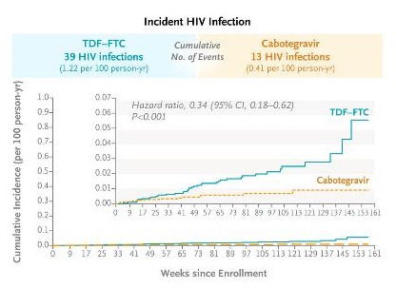
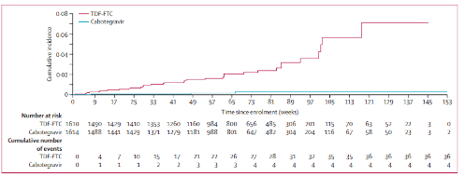
Lancet, April 1, 2022
MSM/TGW: Injectable CAB every 2 m superior to oral TDF/FTC daily
(HIV incidence 66% lower in CAB group)
Women: Injectable CAB every 2 m superior to oral TDF/FTC daily
(HIV incidence 88% lower in CAB group)

Slide 48
Awareness of PrEP Among Cisgender Women in US
Women account for 20% of new HIV diagnoses but only 8% of PrEP users
Almost 1000 sexually active women without HIV surveyed about awareness and interest in PrEP in 2021
7 in 10 had heard of PrEP but only about 1 in 3 had talked to health care provider about PrEP

Slide 49
PrEP: Where We Are Now and Where We Need to Be
More than decade since PrEP was shown to be effective in preventing HIV, still under-utilized
In 2021, CDC revised PrEP guidelines to recommend that “all sexually active adult and adolescent patients should receive information about PrEP.”
Information about PrEP needs to be fully integrated into primary care and discussed with all sexually active women and men

Slide 50
Summary
Diagnosing and treating HIV as soon as possible remains a high priority
Current antiretroviral options work well, even in people with high HIV RNA, low CD4 counts
For patients who are virologically suppressed, many options to simplify therapy, including long-acting injectable CAB/RPV; more data needed on CAB/RPV in people who are viremic
In people with NRTI resistance, combining a drug with high barrier to resistance (DRV/r, DTG, BIC) with tenofovir/FTC or 3TC likely to achieve or maintain viral suppression
Lenacapavir for treatment of multi-drug resistant HIV may be approved soon
Coinfections, including viral hepatitis, COVID-19 and monkeypox virus, pose new challenges and opportunities
Need to expand PrEP access and integrate its use into primary care

